Slide 1
SQL for Data Querying and Analysis
Week 1 Lecture

Slide 2
Agenda
Introduction
Course Overview and Structure
MySQL Workbench Overview
Why Should I learn SQL?
What are Relational Databases?
Let’s Code!

Slide 3
Introduction!
A little bit about myself…
I graduated from UNC Chapel Hill in 2014 and received my MS in Business Analytics at Fordham University in 2016
I currently work as an analytical consultant at SAS in Cary and previously worked for IBM (use a lot of SQL in both roles!)
Outside of work I enjoy playing soccer, running and spending time with my cat

Slide 4
Course Overview
5 week course, each week is a different unit
Each week consists of a lecture (Tuesday) and a lab (Thursday)
Lectures will be a mixture of slides and demos
Labs will be fully interactive and consist of SQL practice problems that you will complete and submit during class time
Office hours are Wednesdays from 5:30 – 7:00 via zoom
All course info can be found on the course GitHub page!

Slide 5
Grading
This is a pass/fail course. Grade breakdown is as follows:
Labs (33% of grade)
Mid Term Assignments (33% of grade)
Final Assignment (33% of Grade)

Slide 6
How to Succeed!
Spend time with provided code as opposed to provided slides
Write your own code from scratch
Ask questions

Slide 7
MySQL Workbench
MySQL Workbench is the querying tool we will be using for this course (type SQL code into the tool and get data back!)
MySQL Workbench sits on top of MySQL Server which is a widely used open-source relational database management system (RDBMS)
Everyone should have it installed by now and be connected to data!
More info and usage tips and tricks can be found in installation instructions
Note: Please close out of MySQL Workbench when not actively querying!

Slide 8
What is SQL?
SQL stands for Structured Querying Language
Initially developed at IBM in the early 1970’s
SQL is how we communicate with databases!
We can use SQL to pull, edit, or add information to a database
SQL is typed into a querying tool of your choice

Slide 9
Why should you learn SQL?
Universally used across industries!
Data analysts, scientists and engineers use it and so can you!
No more barriers between you and your data
Databases are interesting and worth having conversations with ;)

Slide 10
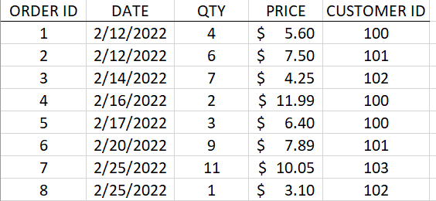
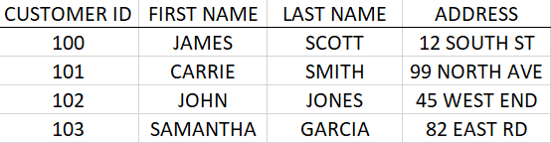
What are Relational Databases?
Relational databases store data in tables that are related to one another
They are key to understanding and writing effective SQL code!
Every row in every table has a unique key that identifies the row and can help relate the table to other tables in the database
Why not store data in a spreadsheet??
ORDERS TABLE
CUSTOMERS TABLE

Slide 11
Let’s Code!

Slide 12
Anatomy of a SQL Query
SELECT
COLUMN_1, SUM(COLUMN_2)
FROM
TABLE_NAME
WHERE
COLUMN_1 = ‘VALUE’
GROUP BY
COLUMN_1
HAVING
SUM(COLUMN_2) > 10
ORDER BY
COLUMN_1;
Select Clause
From Clause
Where Clause
Group By Clause
Having Clause
Order By Clause

Slide 13
Anatomy of a SQL Query
SELECT
COLUMN_1, SUM(COLUMN_2)
FROM
TABLE_NAME
WHERE
COLUMN_1 = ‘VALUE’
GROUP BY
COLUMN_1
HAVING
SUM(COLUMN_2) > 10
ORDER BY
COLUMN_1;
Select Clause
The select clause determines which columns will be included in the query’s result

Slide 14
Anatomy of a SQL Query
SELECT
COLUMN_1, SUM(COLUMN_2)
FROM
TABLE_NAME
WHERE
COLUMN_1 = ‘VALUE’
GROUP BY
COLUMN_1
HAVING
SUM(COLUMN_2) > 10
ORDER BY
COLUMN_1;
From Clause
The from clause determines which tables to retrieve data from and how they should be joined

Slide 15
Anatomy of a SQL Query
SELECT
COLUMN_1, SUM(COLUMN_2)
FROM
TABLE_NAME
WHERE
COLUMN_1 = ‘VALUE’
GROUP BY
COLUMN_1
HAVING
SUM(COLUMN_2) > 10
ORDER BY
COLUMN_1;
Where Clause
The where clause filters out unwanted rows of data based on conditions

Slide 16
Anatomy of a SQL Query
SELECT
COLUMN_1, SUM(COLUMN_2)
FROM
TABLE_NAME
WHERE
COLUMN_1 = ‘VALUE’
GROUP BY
COLUMN_1
HAVING
SUM(COLUMN_2) > 10
ORDER BY
COLUMN_1;
The group by clause groups rows together by common column values
Group By Clause

Slide 17
Anatomy of a SQL Query
SELECT
COLUMN_1, SUM(COLUMN_2)
FROM
TABLE_NAME
WHERE
COLUMN_1 = ‘VALUE’
GROUP BY
COLUMN_1
HAVING
SUM(COLUMN_2) > 10
ORDER BY
COLUMN_1;
The having clause filters out unwanted groups based on conditions
Having Clause

Slide 18
Anatomy of a SQL Query
SELECT
COLUMN_1, SUM(COLUMN_2)
FROM
TABLE_NAME
WHERE
COLUMN_1 = ‘VALUE’
GROUP BY
COLUMN_1
HAVING
SUM(COLUMN_2) > 10
ORDER BY
COLUMN_1;
The order by clause sorts the output of the query by one or multiple columns
Order By Clause

Slide 19
SQL Syntax Best Practices
Each column in select clause on its own line
SELECT
COLUMN_1
, SUM(COLUMN_2)
FROM
TABLE_NAME
WHERE
COLUMN_1 = ‘VALUE’
-- Filter data here
GROUP BY
COLUMN_1
HAVING
SUM(COLUMN_2) > 10
ORDER BY
COLUMN_1;
Put key words on their own line and indent lines with no key words (indents are key!)
Capitalize key words!
Use double dash (--) to comment your code
End query with a semi colon

Slide 20
Select Clause

Slide 21
Select Clause
The select clause determines which columns will be included in the query’s result
The select clause is one of two required clauses along with the from clause
Select clause can include column names, strings, expressions, function calls

Slide 22
Select Clause - Expressions
Concatenate: COLUMN_A || COLUMN_B
Addition: COLUMN_A + COLUMN_B
Subtraction: COLUMN_A - COLUMN_B
Multiplication: COLUMN_A * COLUMN_B
Division: COLUMN_A / COLUMN_B

Slide 23
Select Clause - Functions
SQL has several useful functions that can be used in the select clause and elsewhere in your query
Here is an exhaustive list
Examples:
Select absolute value: SELECT ABS(COLUMN_1)
Round to 2 decimal places: SELECT ROUND(COLUMN_1, 2)

Slide 24
Select Clause Uses
Retrieve every column in a table: SELECT *
Retrieve row count of a table: SELECT COUNT (*)
Create aliases (or labels) for a column in the query output: SELECT COLUMN AS First_Column
Retrieve unique values of a column: SELECT DISTINCT COLUMN

Slide 25
Demo Set 1.1

Slide 26
From Clause

Slide 27
From Clause
The from clause determines which tables to retrieve data from and how they should be joined together
Tables can mean many things!
Permanent, temporary, derived, virtual tables (more on that later)
Tables are linked together with joins that leverage keys in each table (more on this later as well!)

Slide 28
Demo Set 1.2

Slide 29
Where Clause

Slide 30
Where Clause
The where clause filters out unwanted rows of data based on conditions
The where clause can include as many conditions as you want
Multiple conditions can be combined using parenthesis and AND/OR logic

Slide 31
Where Clause Uses
Filter based on equality/inequality
Filter based on ranges
Equal to 20 | WHERE COLUMN = 20
Not equal to 20 | WHERE COLUMN <> 20
Less than or equal to 20 | WHERE COLUMN <= 20
Between 20 and 30 (inclusive) | WHERE COLUMN BETWEEN 20 AND 30

Slide 32
Where Clause Uses Cont.
Filter based on membership
Filter based on wildcards
Equal to A, B or C | WHERE COLUMN IN (‘A’, ‘B’, ‘C’)
Not equal to A, B, or C | WHERE COLUMN NOT IN (‘A’, ‘B’, ‘C’)
Begins with S | WHERE COLUMN LIKE ‘S%’
Does not end with S | WHERE COLUMN NOT LIKE ‘%S’
Contains substring ‘sas’ | WHERE COLUMN LIKE ‘%sas%’
Is a 3 letter string with b in the second position | WHERE COLUMN LIKE ‘_b_’

Slide 33
Where Clause Uses Cont.
Filter based on NULLs
Important to remember when dealing with nulls!
A value can be null but it cannot equal null
Two nulls are never equal to one another
IS NULL | WHERE COLUMN IS NULL
IS NOT NULL | WHERE COLUMN IS NOT NULL

Slide 34
Demo Set 1.3

Slide 35
Pop Quiz!

Slide 36
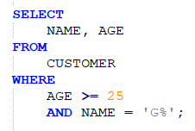
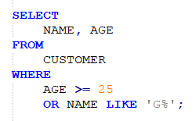
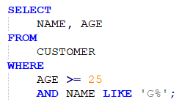
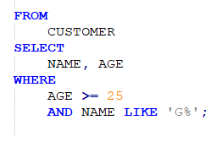
Which query retrieves the name and age columns from the CUSTOMER table of every customer that is at least 25 years old and whose name begins with G?
A)
B)
C)
D)

Slide 37
Which query retrieves the name and age columns from the CUSTOMER table of every customer that is at least 25 years old and whose name begins with G?
A)
B)
C)
D)

Slide 38
Group By Clause

Slide 39
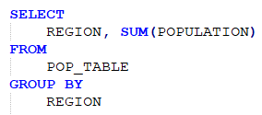
Group By Clause
In databases data is stored at the most granular level and so far we have only accessed data in its original and most granular and raw form
The group by clause allows us to manipulate our data via grouping or aggregation across common column values
The group by clause is typically used with an aggregate function but does not need to be
Available Aggregate Functions: MAX(), MIN(), AVG(), SUM(), COUNT()
An aggregate function used without a group by aggregates entire dataset

Slide 40
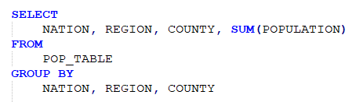
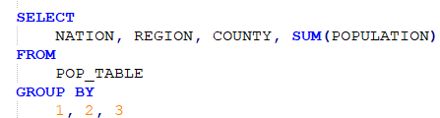
Grouping by Multiple Columns
Group by statements with multiple columns are necessary when aggregating across more than one column
Every column in select clause that is being aggregated across needs to be included in group by statement!
Numeric placeholders are excellent when grouping by more than 1 columns…

Slide 41
Demo Set 1.4

Slide 42
Having Clause

Slide 43
Having Clause
The having clause filters out unwanted groups based on conditions
While the where clause filters out unwanted rows the group by clause filters out unwanted groups after aggregation
Important distinction!
Queries can include both a where clause and a having clause

Slide 44
Demo Set 1.5

Slide 45
Pop Quiz!

Slide 46
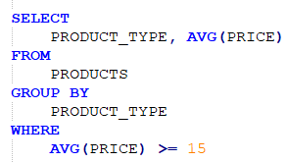
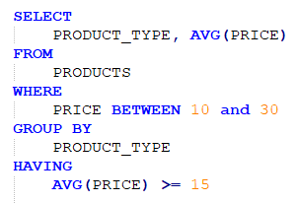
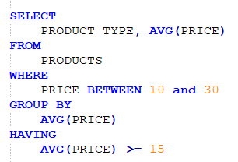
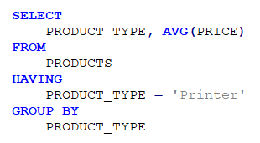
Which query runs successfully?
A)
B)
C)
D)

Slide 47
Which query runs successfully?
A)
B)
C)
D)

Slide 48
Order By Clause

Slide 49
Order By Clause
The order by clause sorts the output of the query by one or multiple columns
By default, the order by clause sorts in ascending order but can sort in descending order as well
Numeric placeholders also work great here!

Slide 50
Demo Set 1.6

Slide 51
Limit Clause (Bonus!)

Slide 52
Limit Clause
The limit clause limits your output to a subset of rows specified in the clause
The limit clause is located at the very end of a query

Slide 53
Demo Set 1.7

Slide 54
Review

Slide 55
Review!
SQL stands for Structured Querying Language and is used to communicate with databases
SQL queries can be made up of up to 6 clauses but only the select clause and from clause are required
The select clause determines which columns will be included in the query’s result
The from clause determines which tables to retrieve data from and how they should be joined together
The where clause filters out unwanted rows of data based on conditions
The group by clause allows us to manipulate our data via grouping or aggregation across common column values
The having clause filters out unwanted groups based on conditions
The order by clause sorts the output of the query by one or multiple columns

Slide 56
Anatomy of a SQL Query
SELECT
COLUMN_1, SUM(COLUMN_2)
FROM
TABLE_NAME
WHERE
COLUMN_1 = ‘VALUE’
GROUP BY
COLUMN_1
HAVING
SUM(COLUMN_2) > 10
ORDER BY
COLUMN_1;
Select Clause
From Clause
Where Clause
Group By Clause
Having Clause
Order By Clause

Slide 57
SQL Syntax Best Practices
Each column in select clause on its own line
SELECT
COLUMN_1
, SUM(COLUMN_2)
FROM
TABLE_NAME
WHERE
COLUMN_1 = ‘VALUE’
-- Filter data here
GROUP BY
COLUMN_1
HAVING
SUM(COLUMN_2) > 10
ORDER BY
COLUMN_1;
Put key words on their own line and indent lines with no key words (indents are key!)
Capitalize key words!
Use double dash (--) to comment your code
End query with a semi colon

Slide 58
Resources to Practice
Code Academy SQL Course: https://www.codecademy.com/learn/learn-sql
SQL Zoo: https://sqlzoo.net/
W3 Schools: https://www.w3schools.com/sql/sql_exercises.asp

Slide 59
Thank You!

